Slide 1
Who We Are and Why We Matter.
www.Samarpanfm.com

Slide 2
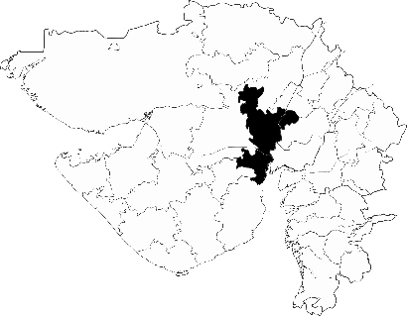
Company Profile
2019
200
1 Cr
300+
Based in
Ahmedabad
Year of
Establishment
Employees
Recruited
FY19
Sales Revenue
Jobs
Completed
Samarpan Facility Management is a provider of contractual and one-time cleaning and maintenance services with a strong focus on delivering both consumer-facing and business-facing solutions.
Our expertise lies in home and office deep cleaning and house keeping services.

Slide 3
About Us
Mission
To make people’s lives easier by creating cleaner living and working spaces and by revolutionizing how these services are delivered to them.
Win-win situation – deliver services to households and corporates and promote welfare by training and employing the unemployed
Growth – Present and Future
200+ Member Organization (Over 1 Years)
Developed expertise in Professional Cleaning Services
2x Revenue and Gross Profit Growth (YoY)
Planned transition to a Franchise Model
Vision
Establish Presence across all major cities in India
Go public – Initial Public Offering by 2020
Skilling the nation’s unemployed through facility management training centers
Engage Innovative service delivery platforms
Aiming for 700+ employees over the next year
Expand to 5 new cities over the next year
Leverage govt. schemes such as Swachh Bharat

Slide 4
Our Services
Sofa
Cleaning
Corporate
Offices
Bathroom
Deep Cleaning
Security
Service
Carpet
Deep Cleaning
House Keeping
Service
Kitchen
Deep Cleaning
Pantry
Deep Cleaning
Home
Deep Cleaning
Services will also be provided at out-of-service timings (early mornings, late nights) at surge prices.

Slide 5
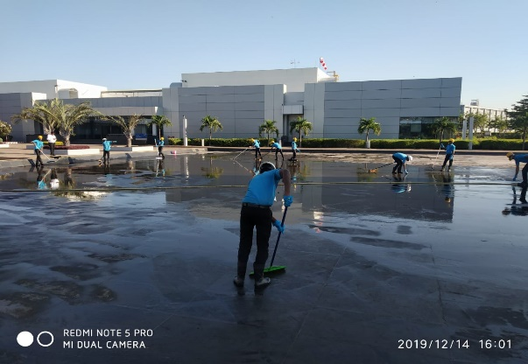
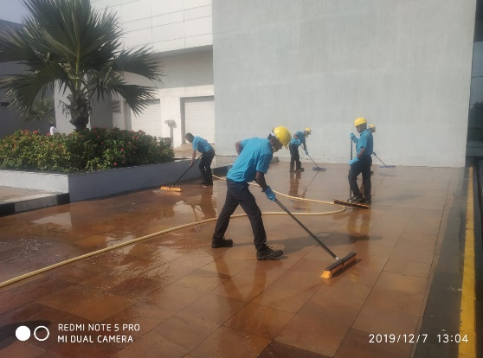
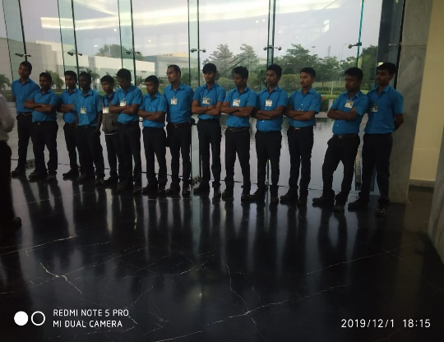
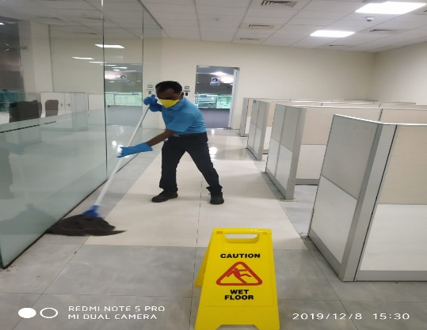
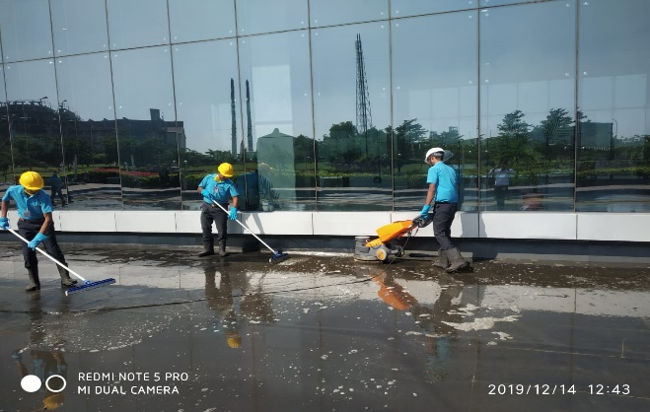
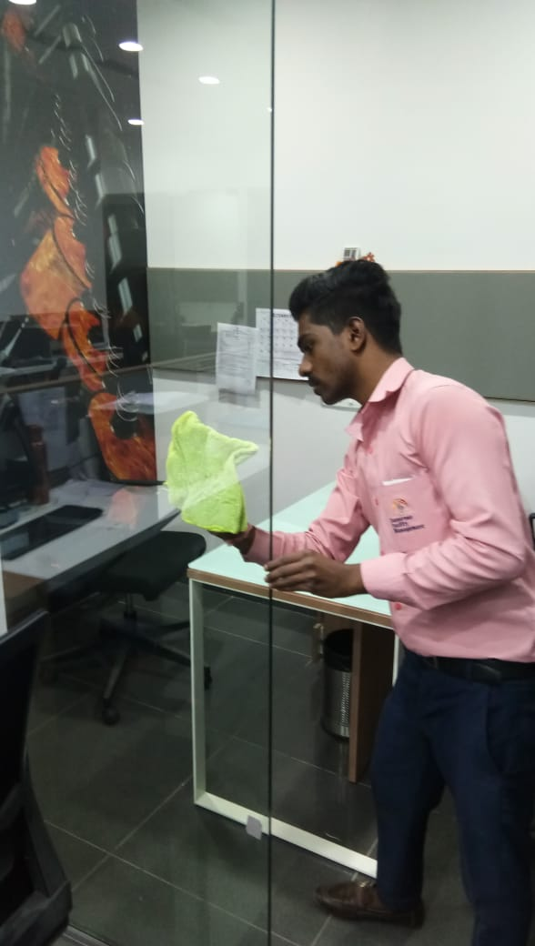
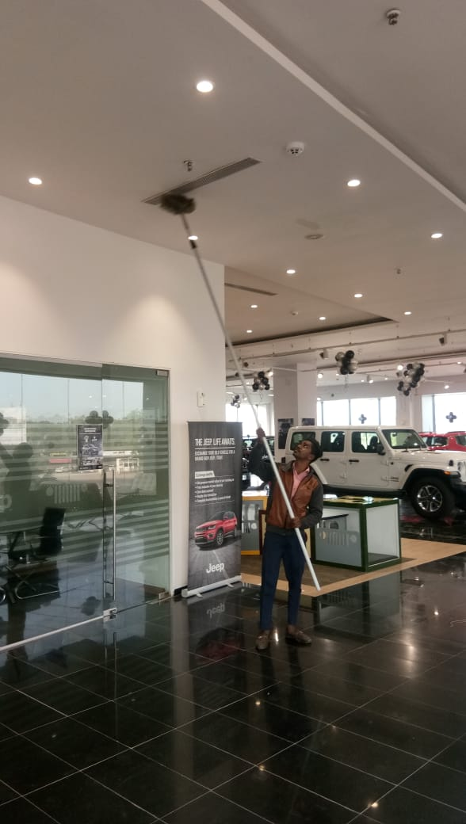
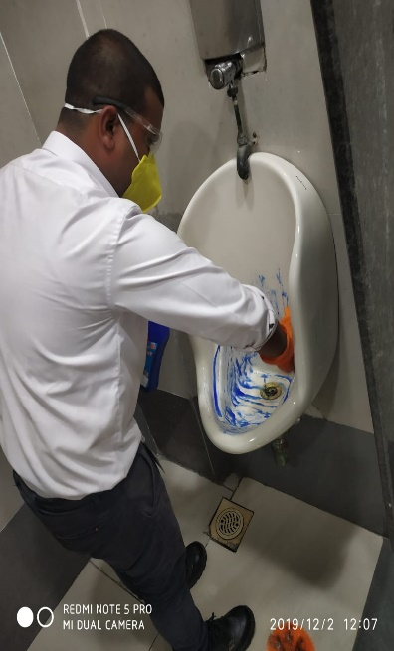
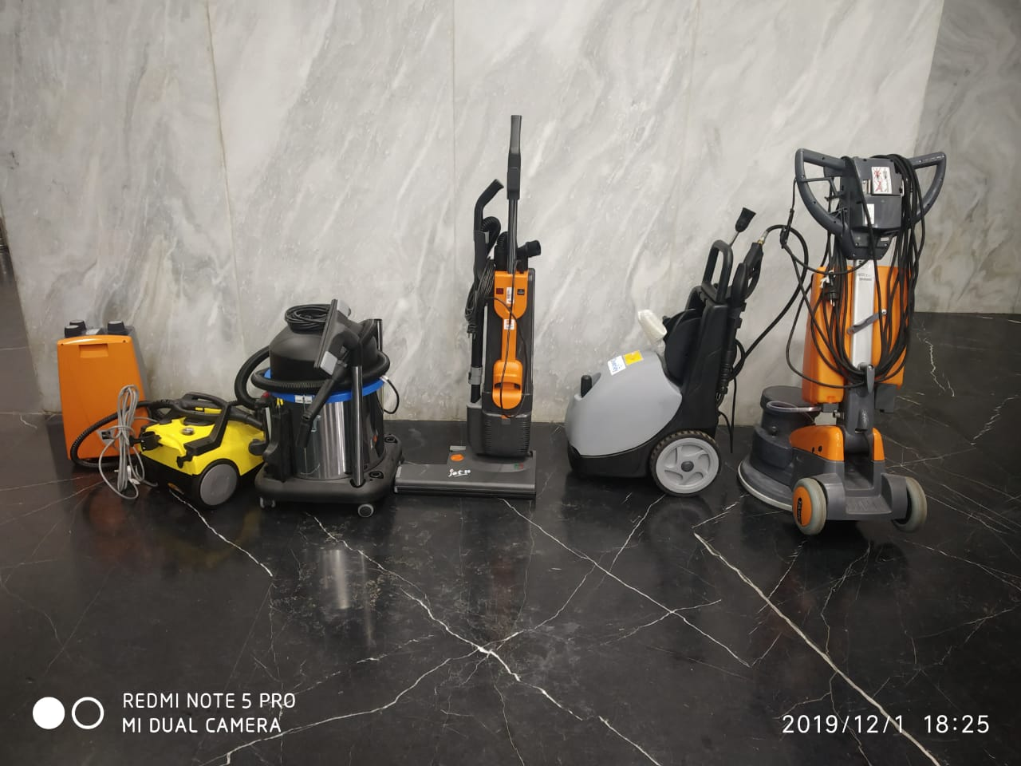
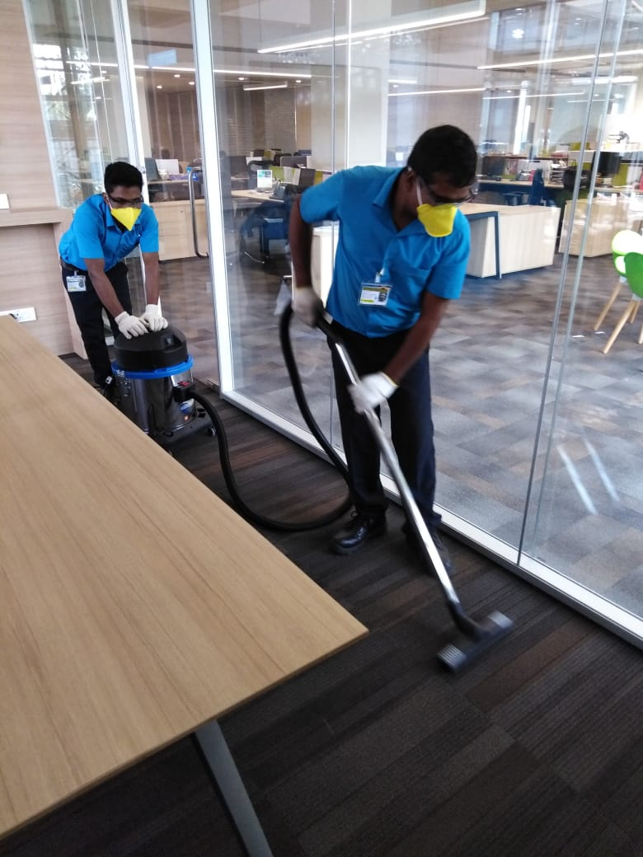
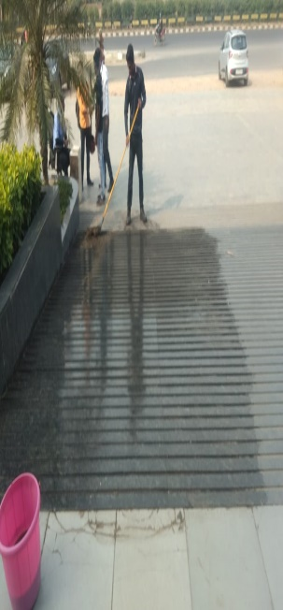
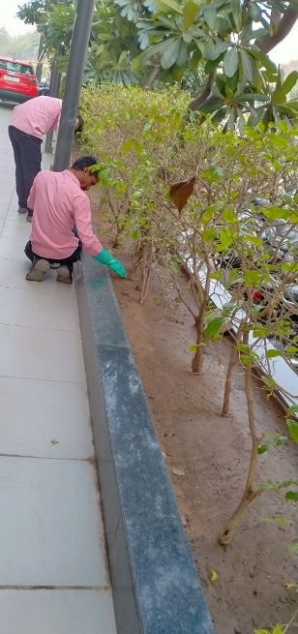
Samarpan Facility Management in Action
House-Keeping
Deep Cleaning

Slide 6
Not Your Ordinary Cleaning Service Provider
Strong focus on professionalism, quality and brand building
Environment
Awareness
Market Leaders in Ahmedabad
Reliable Service
Quality and Delivery
Easy Accessibility
Awarded 2019
Gujarat Most Promising Brand
Well-defined SOPs
For effective
service delivery
Punctuality
95% services
delivered on time
75% Inquiries
of the total Cleaning inquiries
in AMD (amongst
12 competitors)
24 x 7 x 365
Service Availability
Brand Focus
Mandatory uniforms
with safety for
HK staff members
Industry Standard
Environment Friendly
Biodegradable Materials
Easy Bookings
through website,
Samarpan Facility Management
Application available on mobile
Prompt response to requests.
Highly Trained
and smartly dressed
staff. Attempt to
promote inclusion
and diversity
Strict Supervision
For service quality
250 Jobs
completed in
the last 2
months alone

Slide 7
Our Clients

Slide 8
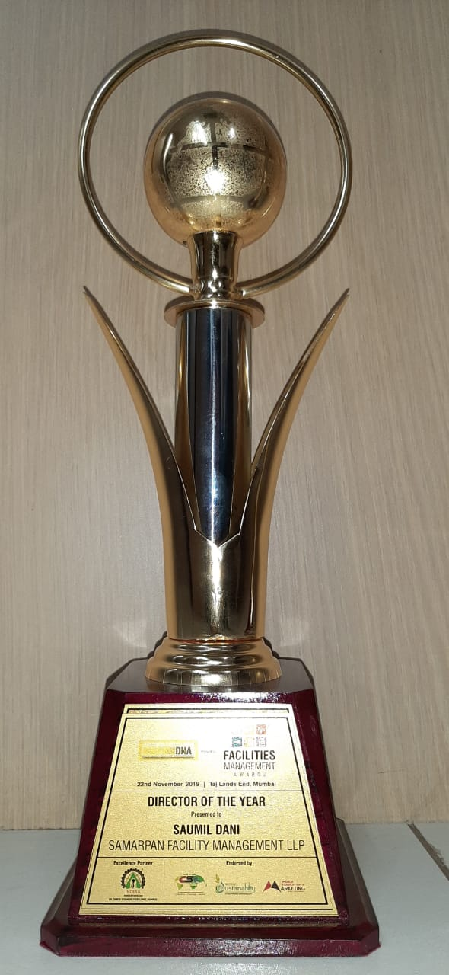
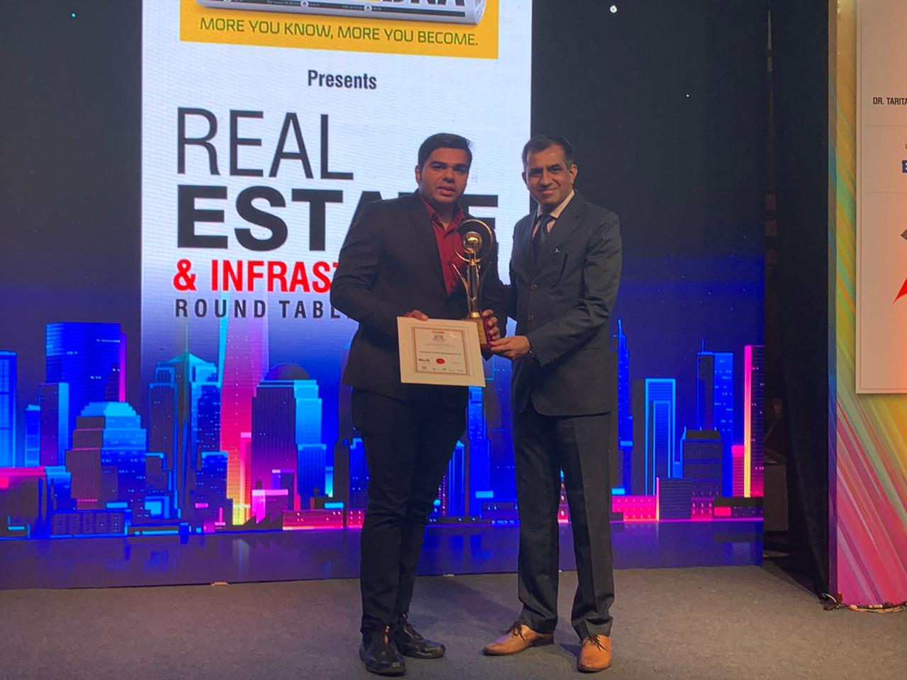
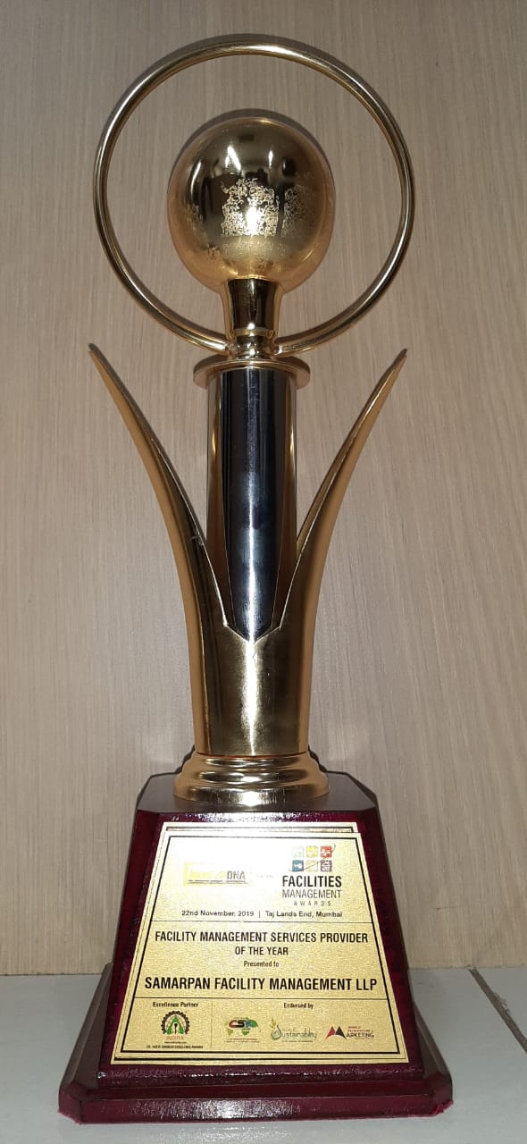
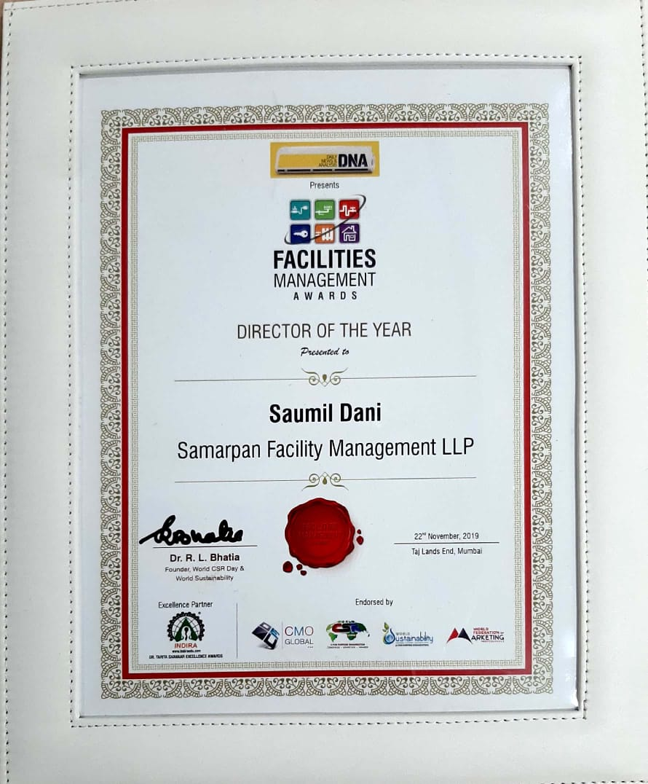
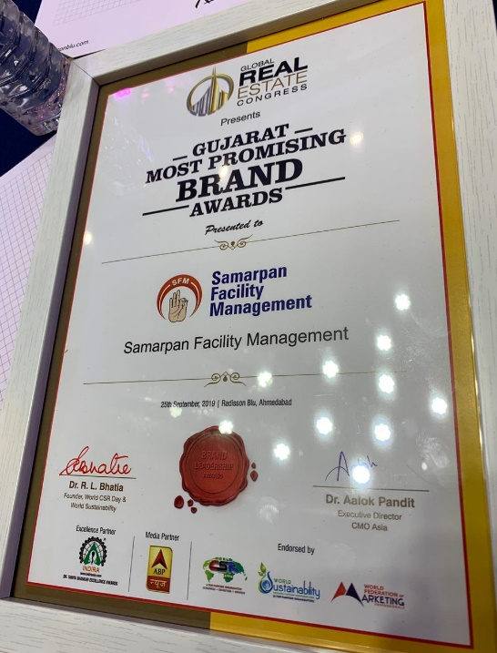
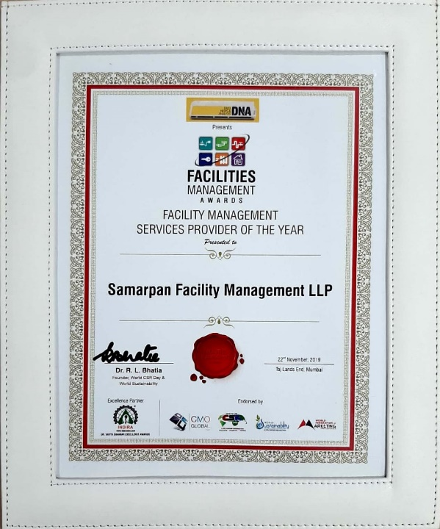
Awards & Rewards
Potential scope for improvement. We aim for over 85% 5 star ratings and reviews over the next 2 years.

Slide 9
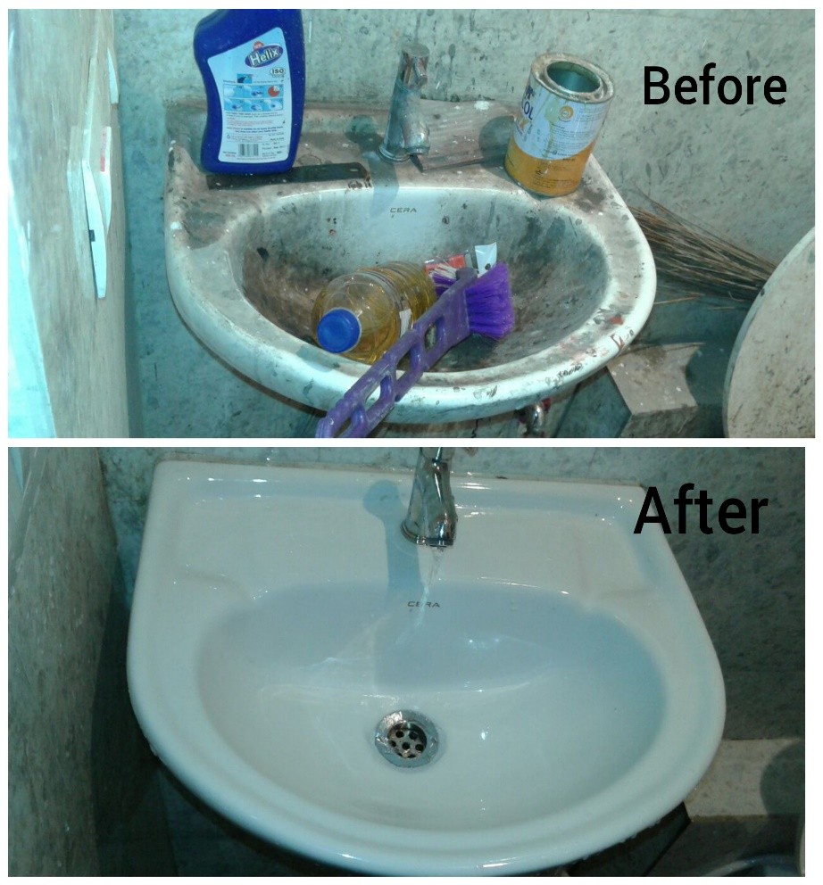
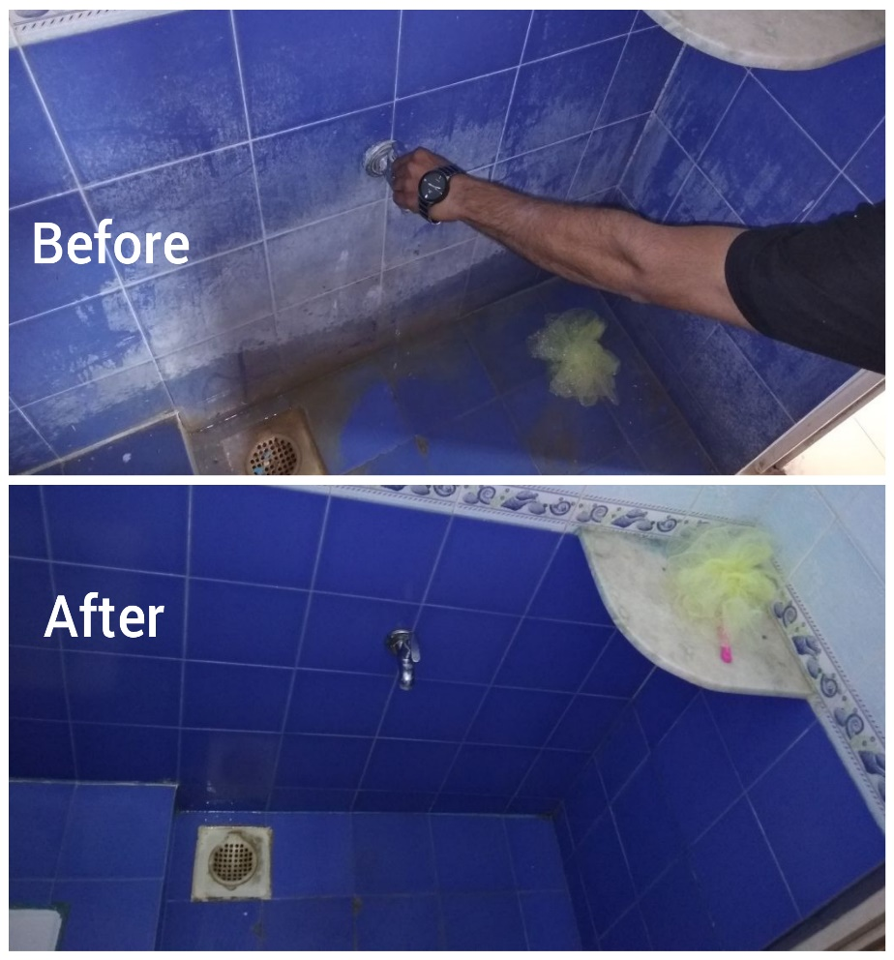
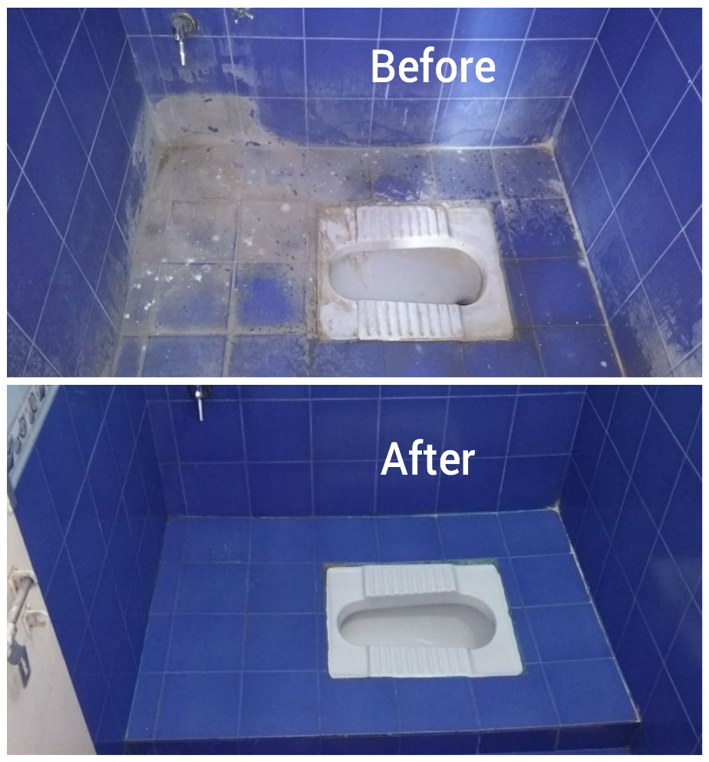
Our Work Speaks for Itself

Slide 10
Target Customers / Request for Referrals
Corporate
Offices, Factories
Housing
Societies
Hospitals
Showrooms
Schools, Colleges
Clubhouses, Gyms
Houses, Flats, Villas
Malls, Cinemas,
Hotels, Restaurants
Event Sites,
Party Plots

Slide 11
Reach us @

Slide 12
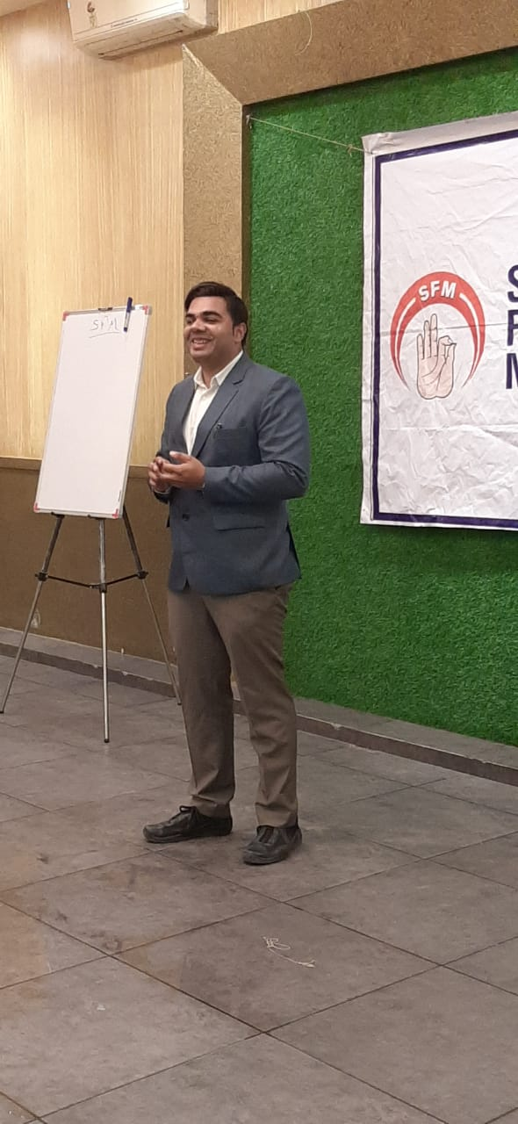
Thank You!
For more information, visit www.samarpanfm.com
Contact:
Mr. Saumil Dani
(Co-Founder and Director, Samarpan Facility Management)
Phone: +91 9727123456

